Slide 1
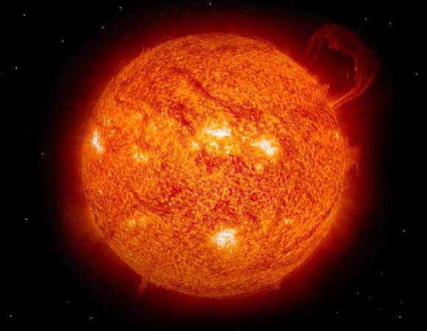
Nature of the solar resource
The sun
The source of all power on the earth
radiates at about 5,777º K
(Blackbody equivalent)

Slide 2
B1.1 Nature of the solar resource
Spectral power distribution of the sun
2.4
2.2
2.0
Spectral power distribution of 6000K blackbody
1.8
Actual Spectral power distribution of the sun
1.6
1.4
Energy distribution (kW/m²/μm)
1.2
1.0
0.8
0.6
0.4
0.2
0.0
0.0
0.2
0.4
0.6
0.8
1.0
1.2
1.4
1.6
1.8
2.0
Wavelength (μm⁻¹)

Slide 3
B1.1 Nature of the solar resource
Irradiance
The amount of the suns energy that reaches the earth (before entering the atmosphere)
The average value of irradiance per year is called the solar constant (G_{sc})and is equivalent to 1353, 1367 or 1373 W/m² depending on who you believe
1353 (±1.5%) from Thekaekara (1976) – derived from measurements at very high atmosphere and used by NASA
1367 (±1%) Adopted by the World Radiation Centre
1373 (±1-2%) from Frohlich (1978) - derived from satellite data

Slide 4
Nature of the solar resource
Earth’s orbit: Variation in radiation

Slide 5
Nature of the solar resource
Earth’s orbit: Variation in radiation
G_{on} = Irradiance
G_{sc} = Solar constant
n = day number (number of days since 1st January)
Note: cosine is for degrees

Slide 6
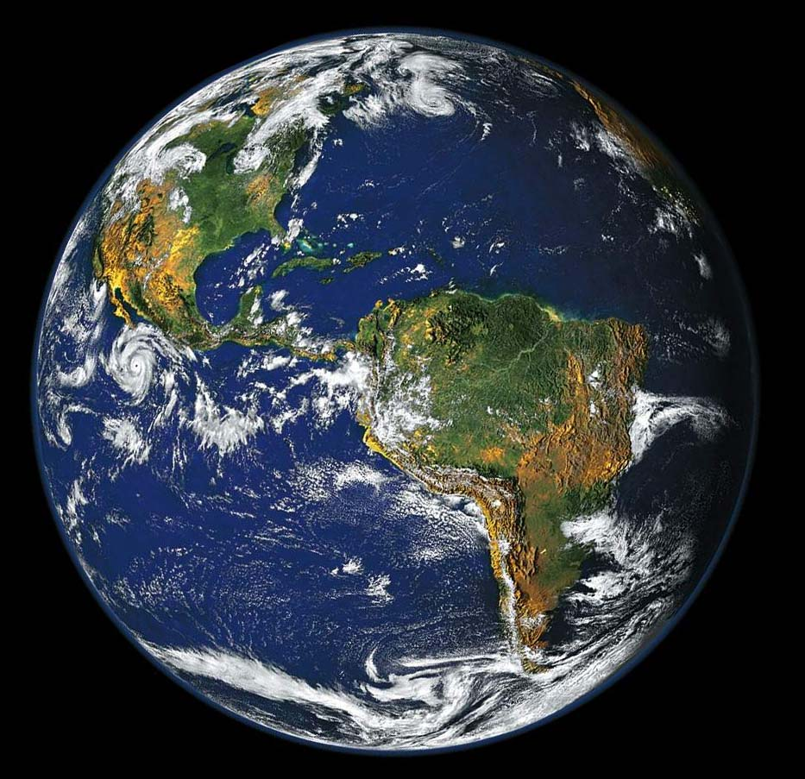
Nature of the solar resource
Earth is tilted 23.45°

Slide 7
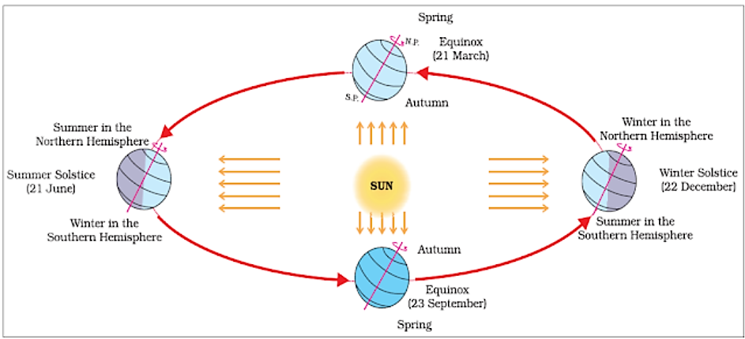
Nature of the solar resource Earth is tilted 23.45°
On the winter solstice (December 22)
  The north pole has its maximum angle of inclination away from the sun
  Everywhere above 66.55° N (90-23.45) is in darkness for 24 hours, Everywhere above 66.55° S is in sunlight for 24 hours
  the sun passes directly overhead over the tropic of Capricorn (23.45° S)
On the equinox (March 21 & September 23)
  Both poles are equidistant
  the day is exactly 12 hours long
  the sun passes directly overhead over the equator
  The sun tracks a straight line across the sky
On the summer solstice
  (June 21)
  The reverse of the winter solstice

Slide 8
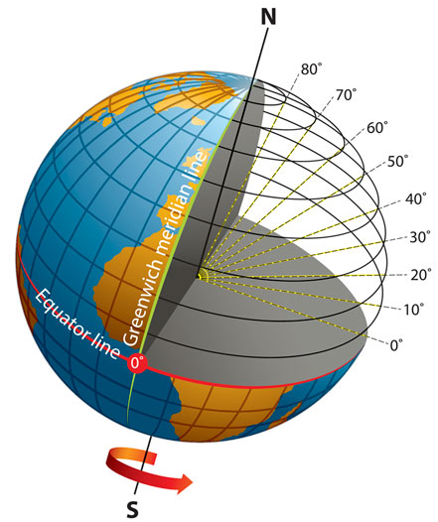
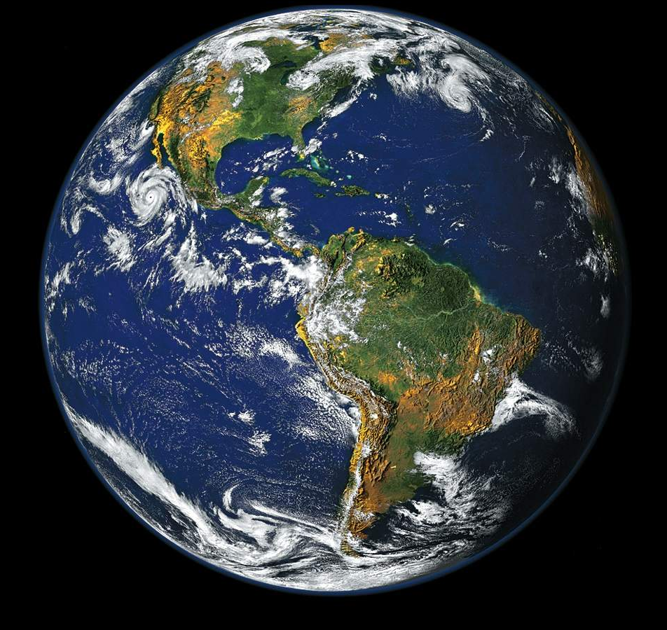
Nature of the solar resource Solar geometry
φ = Latitude measures the distance north or south of the equator. Latitude lines start at the equator (0 degrees latitude) and run east and west, parallel to the equator.
δ = Declination angle is between the earth’s axis of rotation and the surface of a cylinder through the earth’s orbit
n = day number
(number of days since 1st January)
δ
φ
Beam
radiation

Slide 9
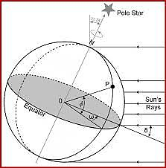
Hour angle (ω)
The angular displacement of the sun east or west of the local meridian due to the rotation of the earth or The angle through which the earth must turn to bring the Meridian of a point directly in line with the Sun’s rays.
It is a measure of the time of the day with respect to Solar noon.
15° per hour
  Noon is zero,
  Morning negative,
  Afternoon positive.
Depends on Apparent Solar Time
AST = Apparent solar time
LCT = Local clock time
TZ = Time zone
L = Longitude (west = +^{ve})
EQT = Equation of time

Slide 10
Equation of time (EOT or EQT)
Solar time: Solar radiation calculations such as the hour angle are based on local solar time (LST).
Since the earth’s orbital velocity varies throughout the year, the local solar time as measure by sundial varies slightly from the mean time kept by the clock running at uniform rate.
A civil day is exactly equal to 24 hours, whereas a solar day is approximately equal to 24 hours.
The variation is called as equation of time (EOT) and is available as average values for different months of the year.
The EOT may be considered as constant for a given day.
An approximate equation for calculating EOT given by Spencer (1971) is:
EOT=0.2292(0.075+1.868cosN - 32.077sinN - 4.615cos2N - 40.89sin2N)
or
where N or B =(n-1)(360/365);
n is the day of the year counted from January 1st
LST=Standard time ±4(Standard Time Longitude – Longitude of Location)+Equation of time correction)
The –ve sign is applicable for Eastern Hemisphere.
NOTE: Hour angle (ω) = 15(12 - LST)

Slide 11
Problem 1: Determine Hour Angle (ω) for : 09:00 AM, 11:00 AM, 02:00 PM, 04:30 PM.
Solution:
Hour angle (ω) = 15 (12 – LST)
09:00AM; ω = 15 (12 – 9) = 45°
11:00AM; ω = 15 (12 – 11) = 15°
02:00PM; ω = 15 (12 – 14) = -30°
04:30AM; ω = 15 (12 – 16.5) = -67.5°
Problem 2: Determine the LST and Declination at a location latitude 23°15’ N, longitude 77°30’ E at 12.30pm IST on June 20. EOT correction = -(1’02”). Standard time Longitude for IST = 82.5°.
Problem 3: Determine the LST and Declination at a location latitude 23°15’ N, longitude 67°30’ E at 2.30pm IST on October 02. EOT correction = -(9’02”). Standard tim Longitude for IST = 82.5°.

Slide 12
Solar geometry: Sun angles
θ_{z}
Horizontal
α_{s}
δ
φ
Beam
radiation

Slide 13

Solar geometry: Sun angles
θ_{z} = Zenith angle – the angle between the vertical (zenith) and the line of the sun
α_{s} = Solar attitude angle – the angle between the horizontal and the line to the sun
γ_{s} = Solar azimuth angle:
The angle of the projection of beam radiation on the horizontal plane (with zero due south, east negative and west positive)
Zenith
θ_{z}
West
North
α_{s}
θ_{Z} = Zenith Angle
φ = Latitude
δ = Declination
ω = Hour angle
γ_{s} = Solar azimuth angle
α_{s} = Solar attitude angle
Note: γ & ω should be the same sign
γ_{s}
South
East

Slide 14
Solar geometry: Sun angles
Sunset angle and day length
ω_{s} = Sunset angle
δ = Declination
φ = Latitude
Note: Day length is in hours

Slide 15
Solar geometry: Collector angles
β
Horizontal
φ
(φ - β)
Beam
radiation
θ
Normal

Slide 16
Solar geometry: Collector angles
Earth angles
Sun angles
θ = Angle of incidence
α_{s} = Solar attitude angle
γ = Surface azimuth angle
γ_{s} = Solar azimuth angle
β = Collector slope
δ = Declination
φ = Latitude
ω = Hour angle
β = Slope – the angle between the plane of the collector and the horizontal
γ = Surface azimuth angle – the deviation of the projection on a horizontal plane of the normal to the collector from the local meridian (with zero due south, east negative and west positive)
θ = Angle of incidence – the angle between the beam radiation on the collector and the normal
θ_{z}
West
Zenith
North
θ
α_{s}
β
γ_{s}
γ
East
South

Slide 17
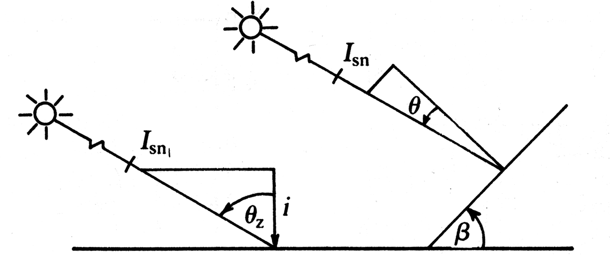
Solar geometry: Collector angles
Northern Hemisphere
ω_{ss} = Sunset angle
δ = Declination
φ = Latitude
β = Collector slope
Southern Hemisphere
System design
Irradiance: Variables:
Latitude at the point of observation
Orientation of the surface in relation to the sun
Day of the year
Hour of the day
Atmospheric conditions
Irradiance on a horizontal surface
G_{b} = Beam Irradiance normal to the earth’s surface (W/m²)
G_{b,n} = Beam Irradiance (W/m²)
θ_{z} = Zenith angle

Slide 18
System design
Tilt: Beam radiation
G_{b,t} = Beam Irradiance normal to a tilted surface (W/m²)
G_{b,n} = Beam Irradiance (W/m²)
θ = Angle of incidence

